Slide 1
NPDES PERMIT REVIEW
Illinois Rural water association

Slide 2
Who to call for help

Slide 3
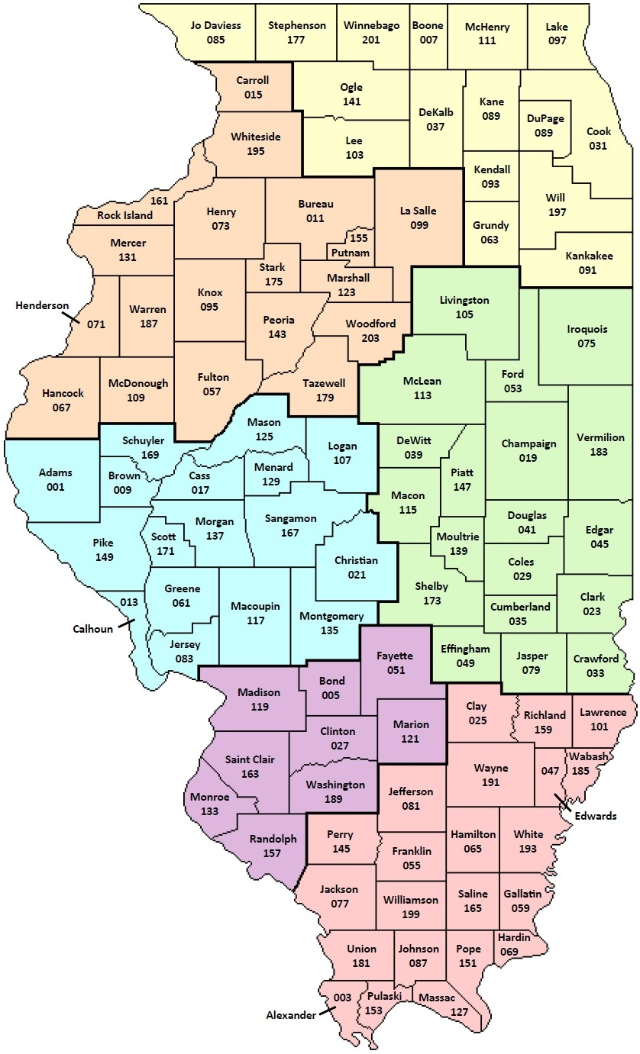
Regional Offices
Region 2 – Des Plaines
Region 3 – Peoria
Region 4 – Champaign
Region 5 – Springfield
Region 6 – Collinsville
Region 7 – Marion

Slide 4
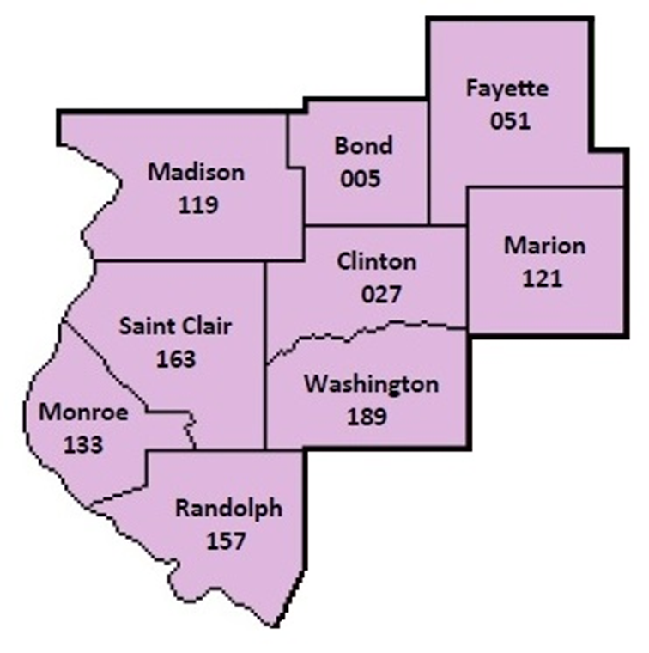
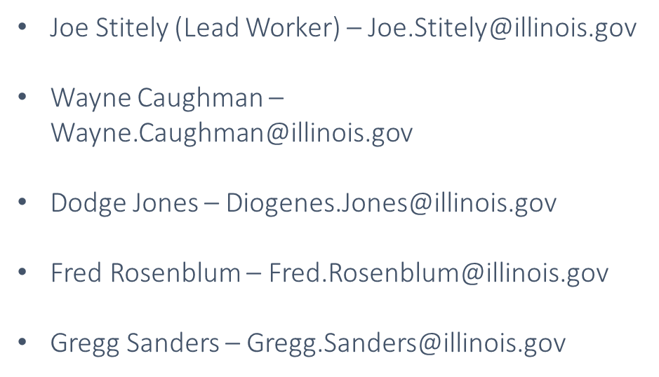
Region 6 – Collinsville Regional Office
1101 Eastport Plaza Drive, Suite 100
Collinsville, Illinois 62234
(618) 346-5120

Slide 5
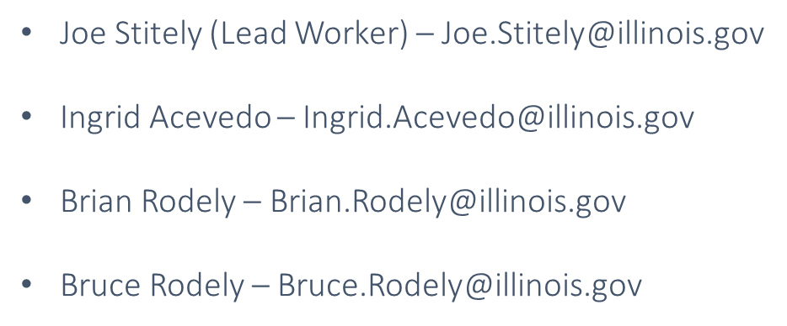
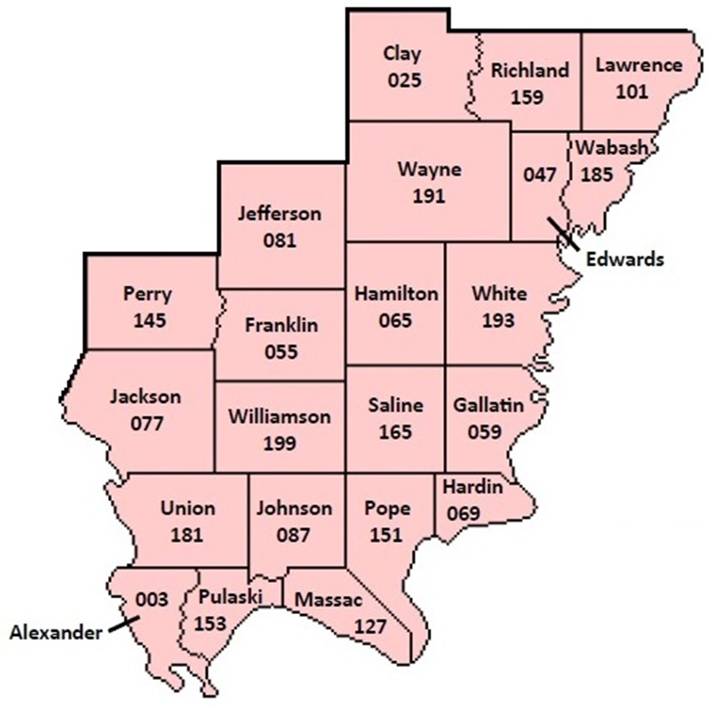
Region 7 – Marion Regional Office
2309 W Main Street
Marion, Illinois 62959
(618) 993-7200

Slide 6
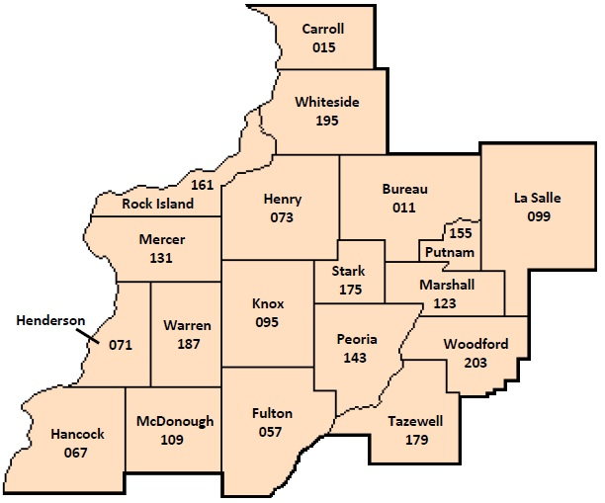
Region 3 – Peoria Regional Office
Paul Jungles – Paul.Jungles@illinois.gov
Ben Neuendorf – Benjamin.Neuendorf@illinois.gov
Kyle Phelps – Kyle.Phelps@illinois.gov
Shannon Soucie – Shannon.Soucie@illinois.gov
412 SW Washington Street, Suite D
Peoria, Illinois 61602
(309) 671-3022

Slide 7
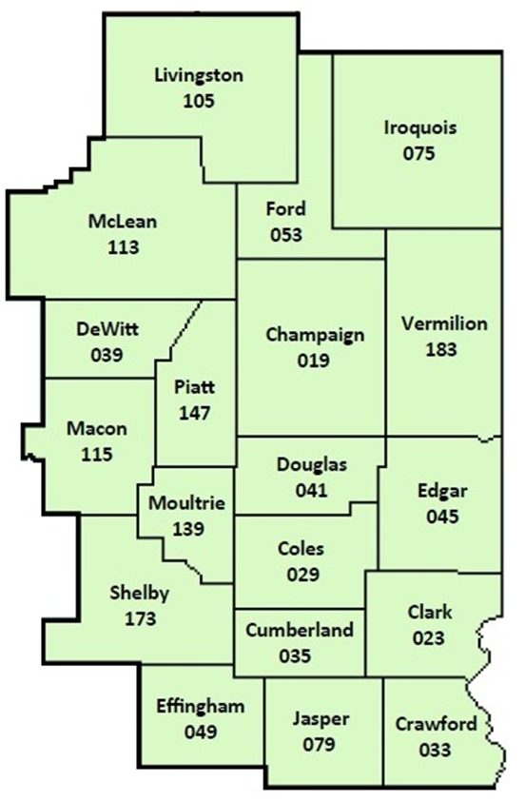
Region 4 – Champaign Regional Office
Jeff Holste, Lead Worker – Jeffrey.Holste@illinois.gov
Darwin Fields – Darwin.Fields@illinois.gov
2125 S First Street
Champaign, Illinois 61820
(217) 278-5800

Slide 8


IEPA FIELD OPERATIONS SECTION
Todd A. Bennett, Manager
Division of Water Pollution Control – Field Operations Section
Bureau of Water
Illinois Environmental Protection Agency
Todd.Bennett@illinois.gov
Desk: (217) 782-8367
Mobile: (217) 299-6879
"… to restore, maintain, and enhance the purity of the waters of this State in order to protect health, welfare, property, and the quality of life..."

Slide 9
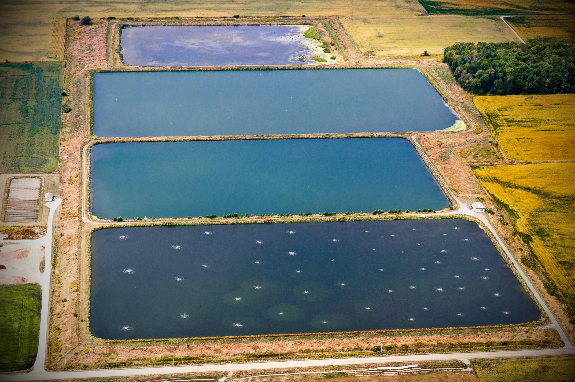
Current Areas of Focus
US EPA National Compliance Initiative (50% reduction in significant non-compliance for NPDES permit universe by end of 2022)
Compliance assistance for small systems
Environmental Justice
Sanitary sewer overflow reporting
Per- and Polyfluoroalkyl Substances (PFAS)

Slide 10
OPERATOR CERTIFICATION
Revisions to the wastewater operator regulations at Part 380 of Title 35 Illinois Administrative Code went into effect July 1, 2019
Established renewal dates and renewal credit requirements
In March 2022, sent 3,240 renewal notifications to Class 3 and Class 4 operators that were certified in 2019 or earlier
Renewal notifications for Class 1 and Class 2 operators that were certified in 2020 or earlier will be sent in Spring 2023
Added exam dates and seats at the Des Plaines testing location (currently plenty of availability)

Slide 11
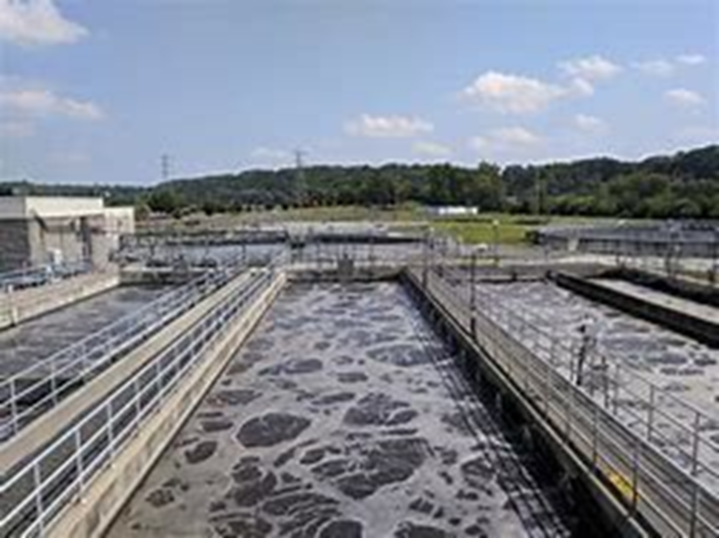
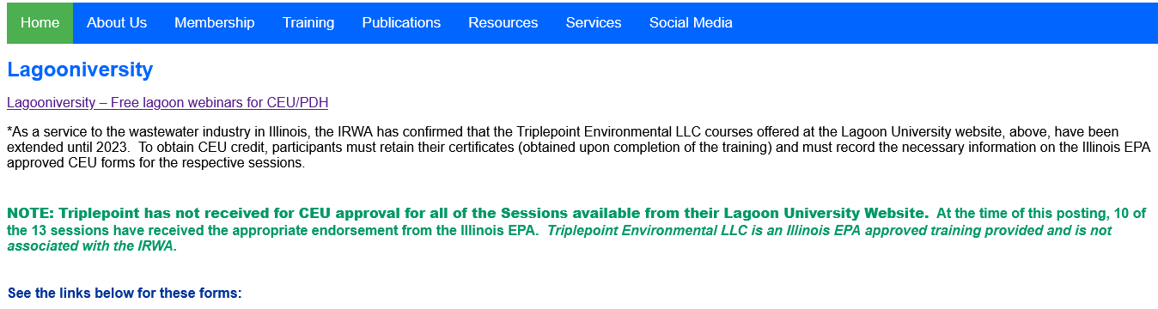
OPERATOR CERTIFICATION

Slide 12
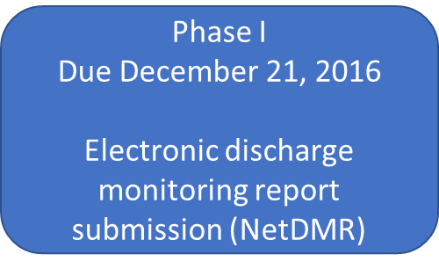
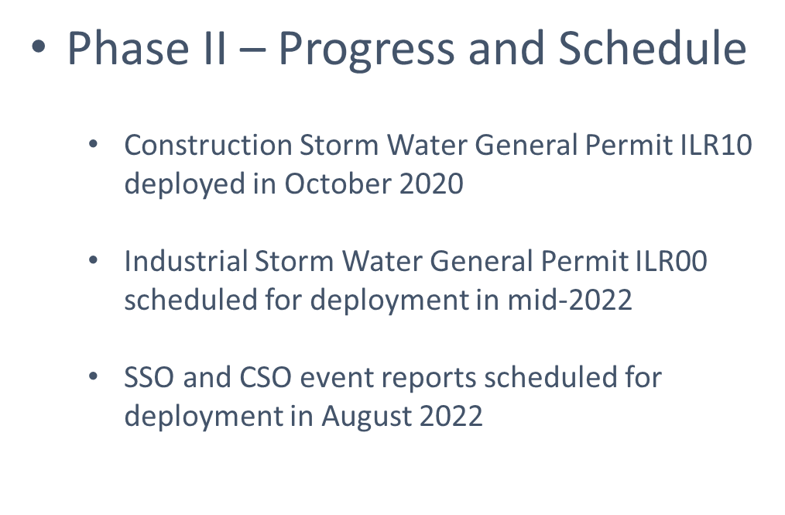
NPDES E-Reporting Rule Implementation
Phase II
Due December 21, 2025
Notices of Intent and reports for general permits and program reports (NeT)

Slide 13
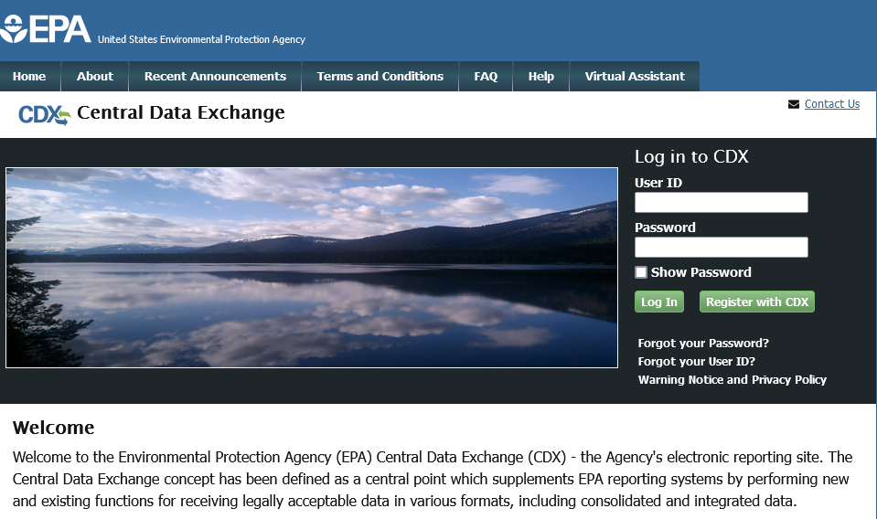

Slide 14
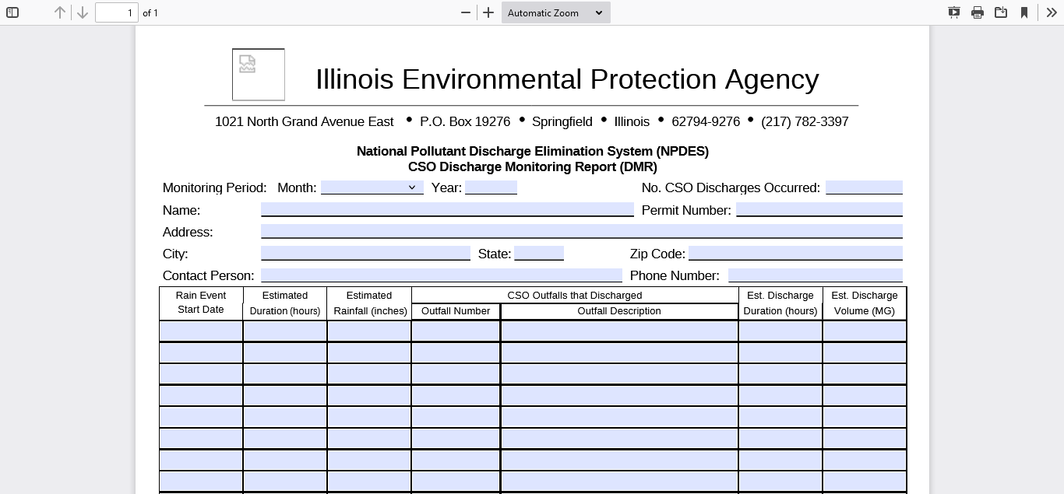

Slide 15
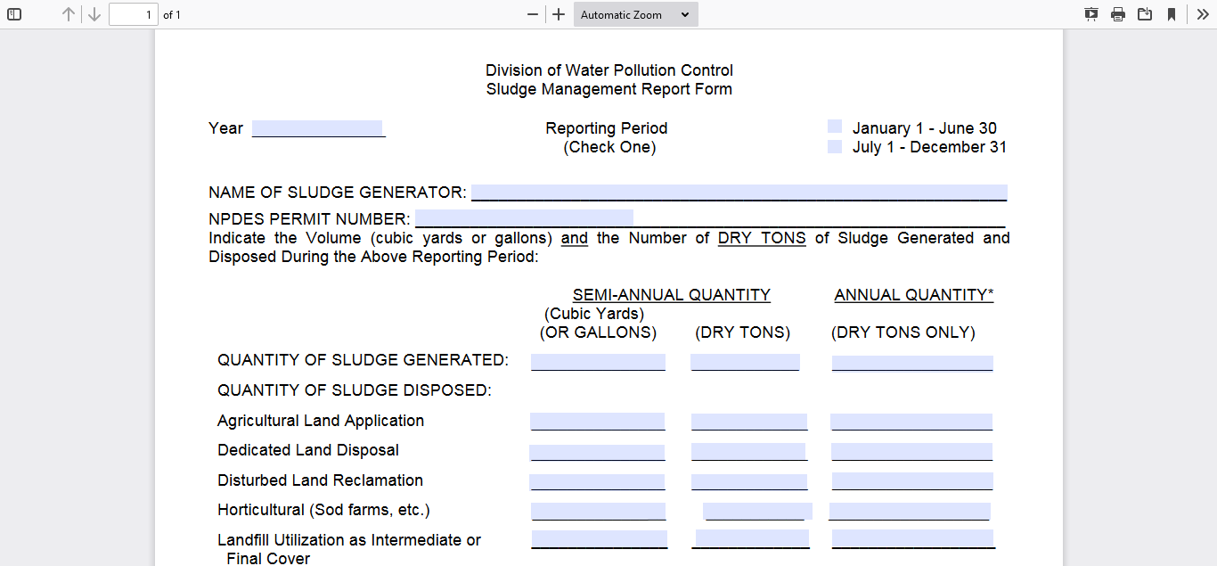

Slide 16
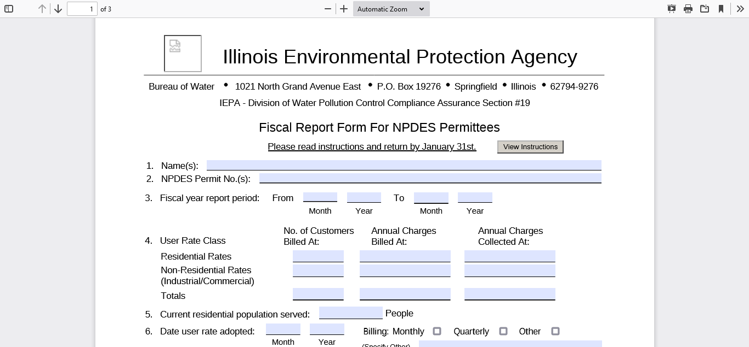

Slide 17
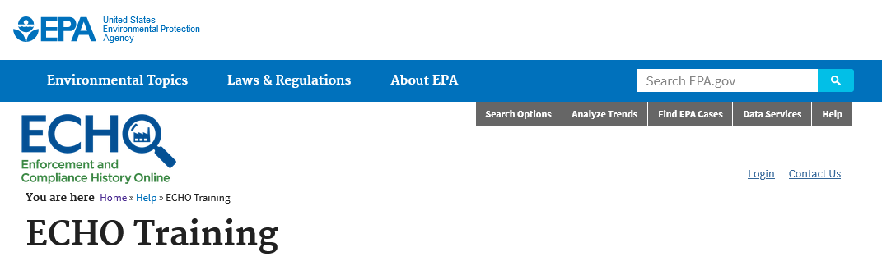
Where do I find compliance information?
https://echo.epa.gov/help/training#upcoming

Slide 18
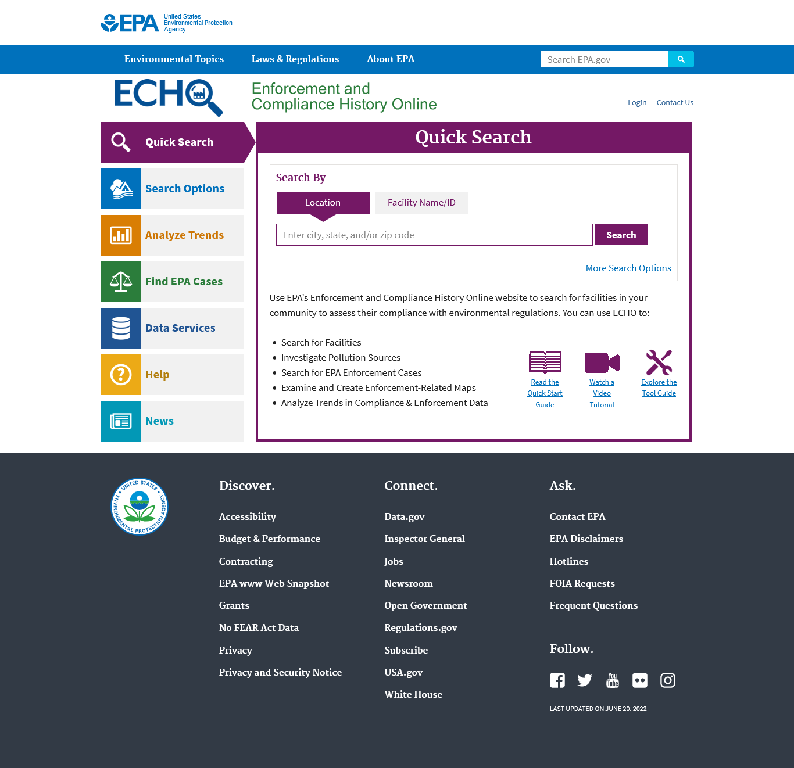

Slide 19
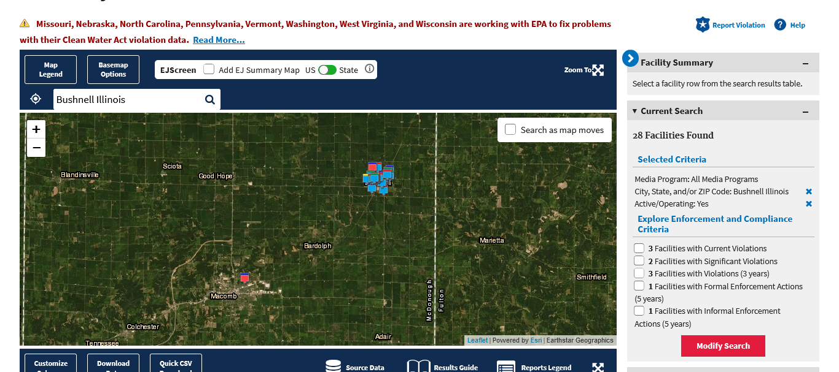

Slide 20
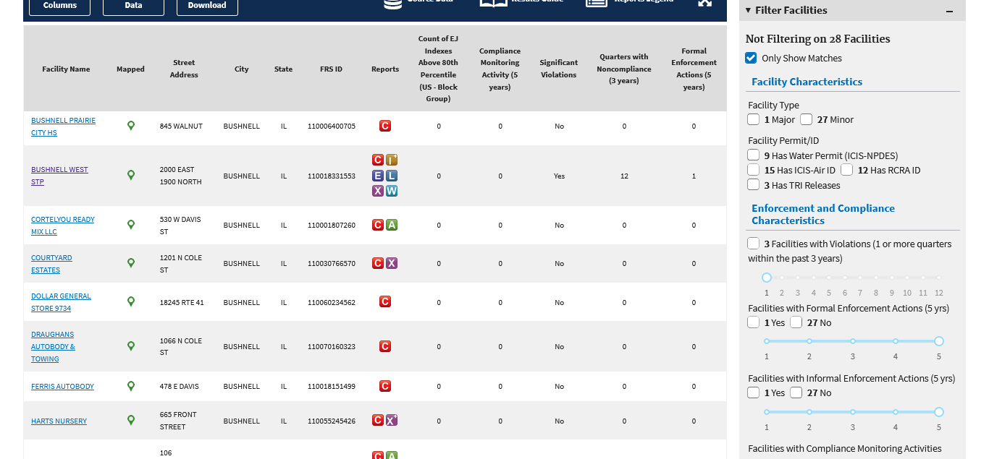

Slide 21
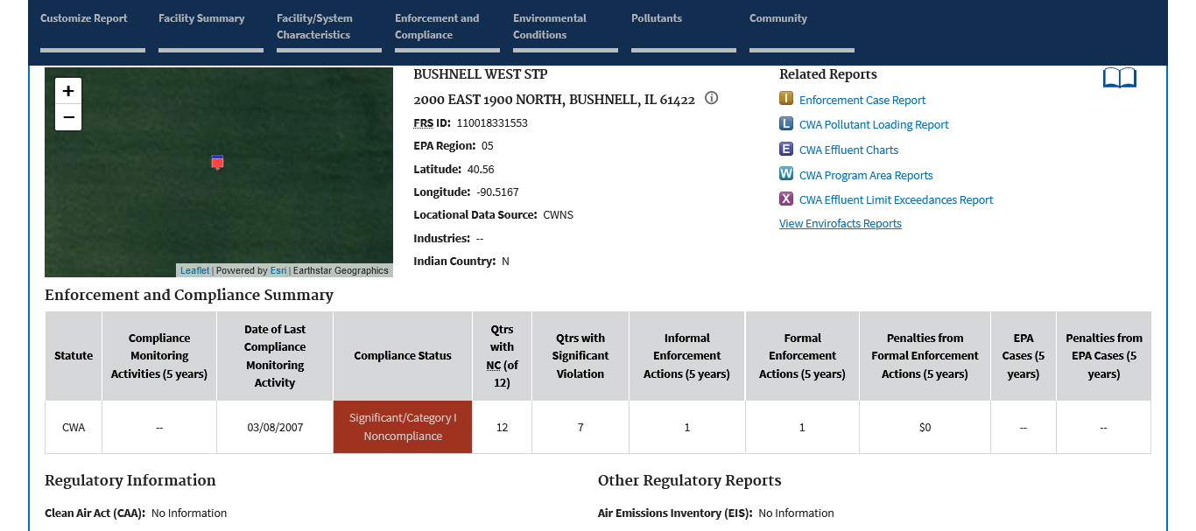

Slide 22
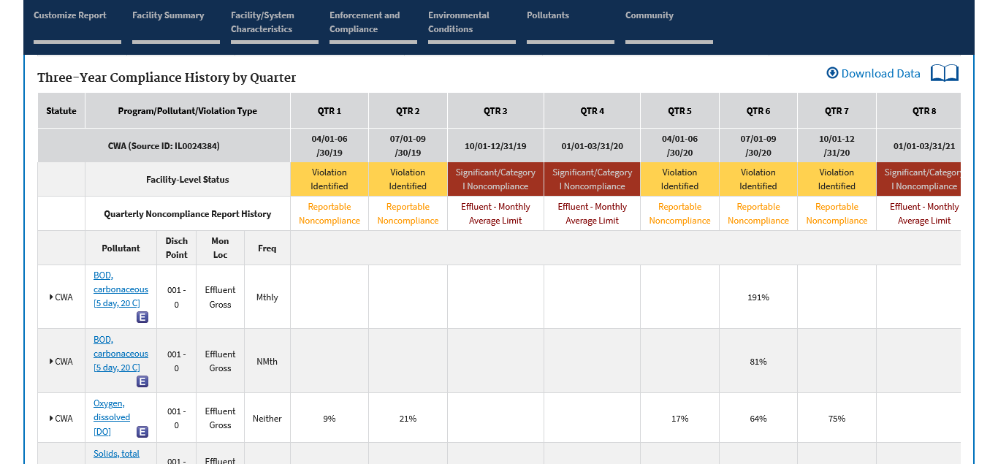

Slide 23
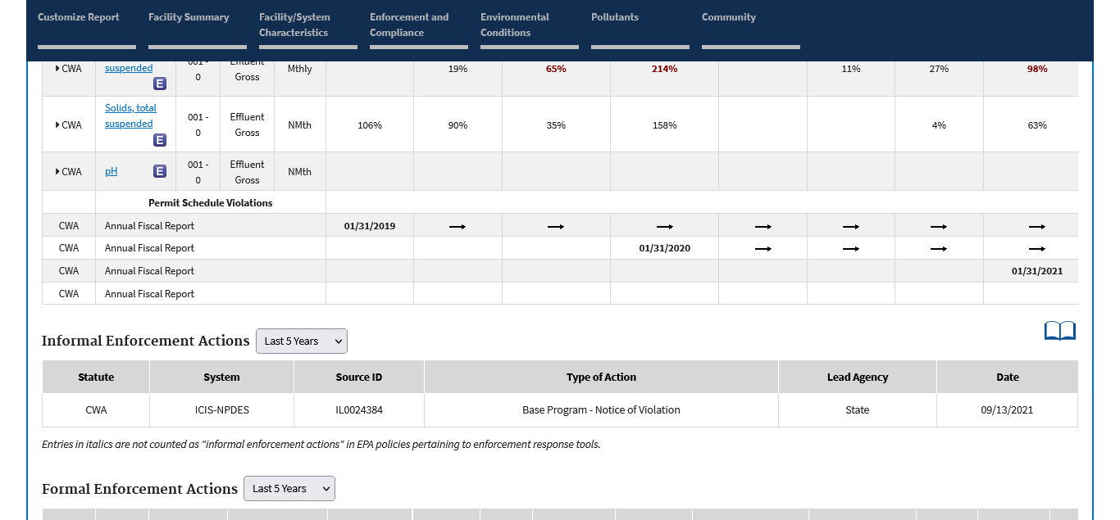

Slide 24
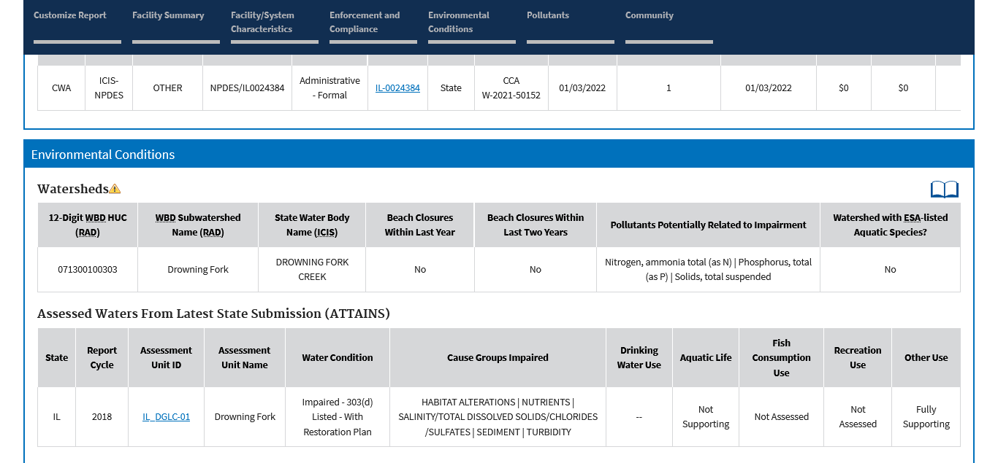

Slide 25
Npdes permits

Slide 26
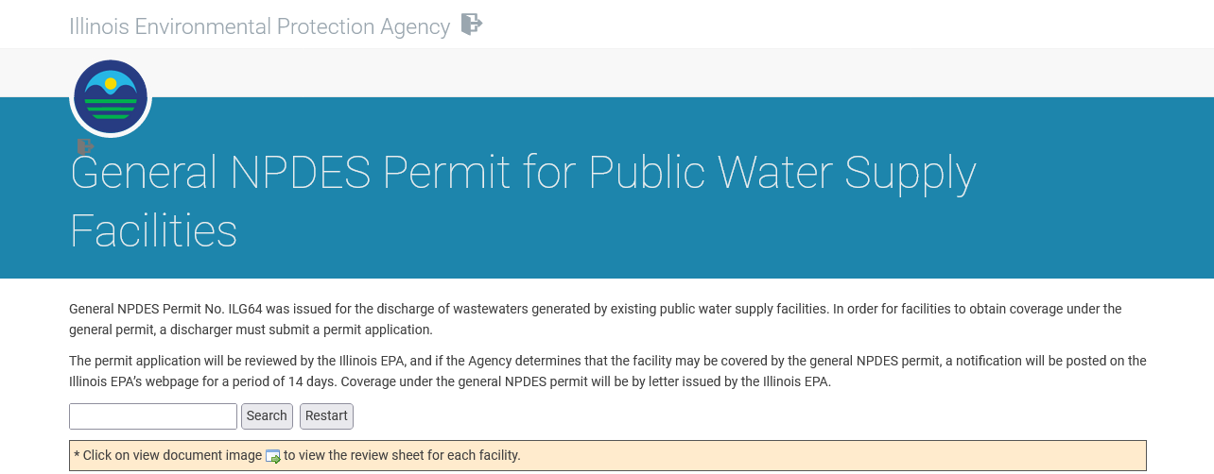
Where to find my npdes permit?
http://www.epa.state.il.us/water/permits/pws-facilities/index.php

Slide 27
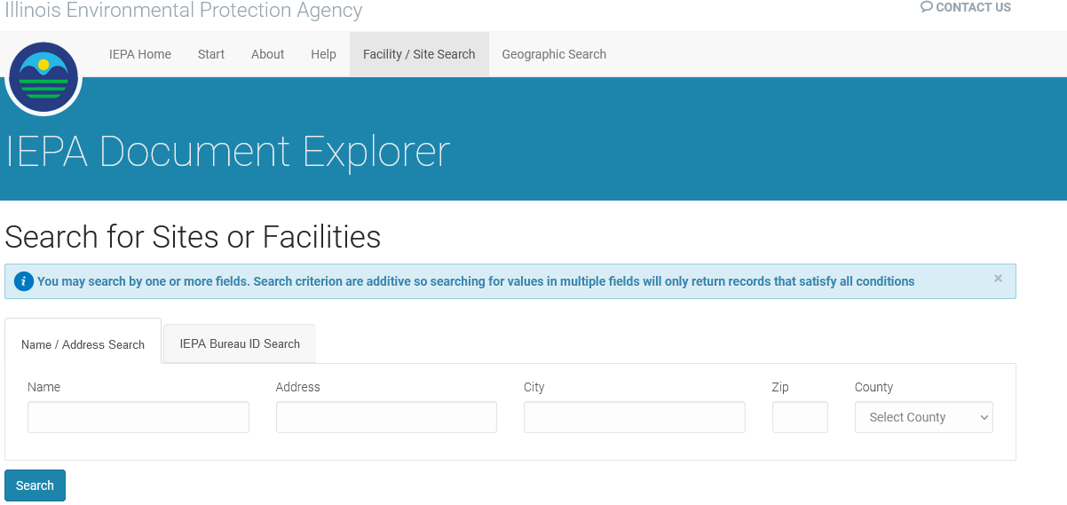
Where do I find my ww npdes permit
https://external.epa.illinois.gov/DocumentExplorer/Attributes

Slide 28
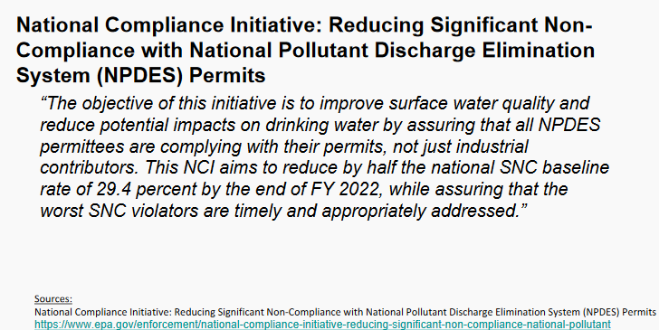
NPDES permits

Slide 29
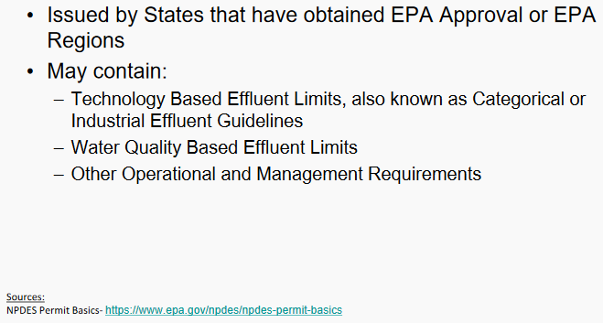
Npdes permit basics

Slide 30
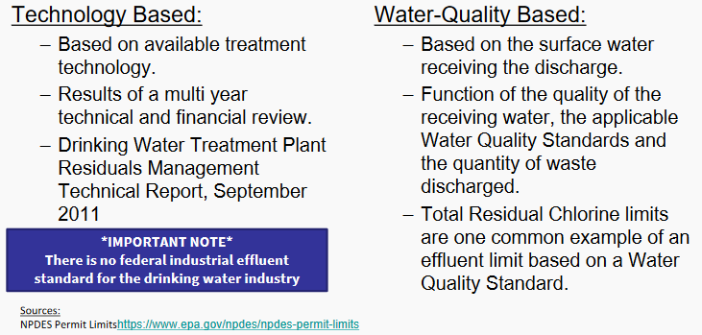
Effluent limits

Slide 31
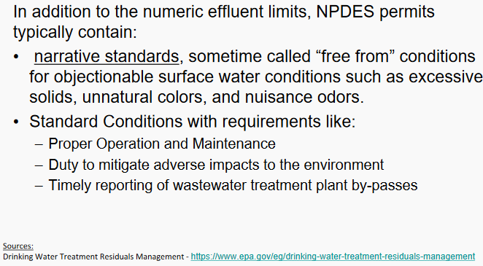
Other npdes requirments

Slide 32
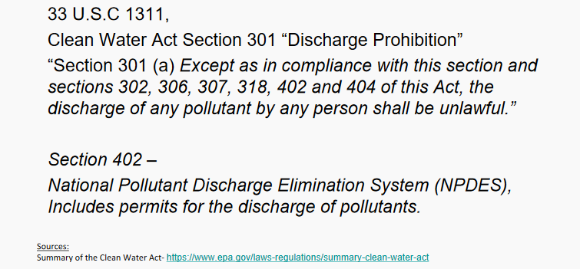
Clean water act discharge prohibition

Slide 33
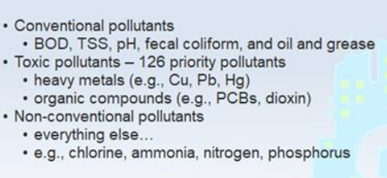
Classes of pollutants

Slide 34
WhO needs an NPDES permit?
Water Treatment Plant Discharges
259 IL water plants have permits
Wastewater Treatment Plant Discharges
Treated Industrial Effluent Discharges
Storm Water Discharges

Slide 35
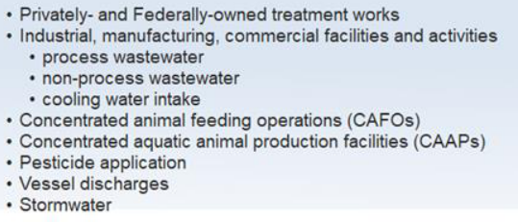
Industrial/non-POTW facilities

Slide 36
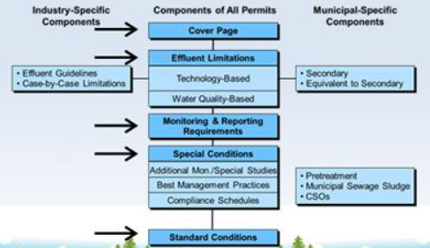
What is in a npdes permit

Slide 37
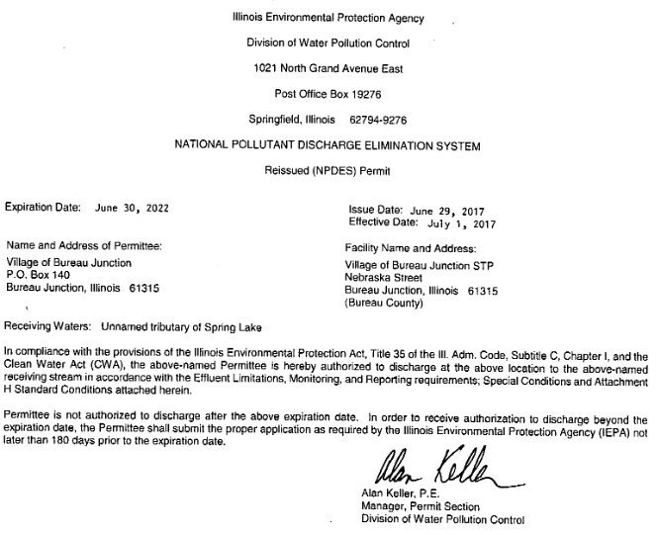
Cover page

Slide 38
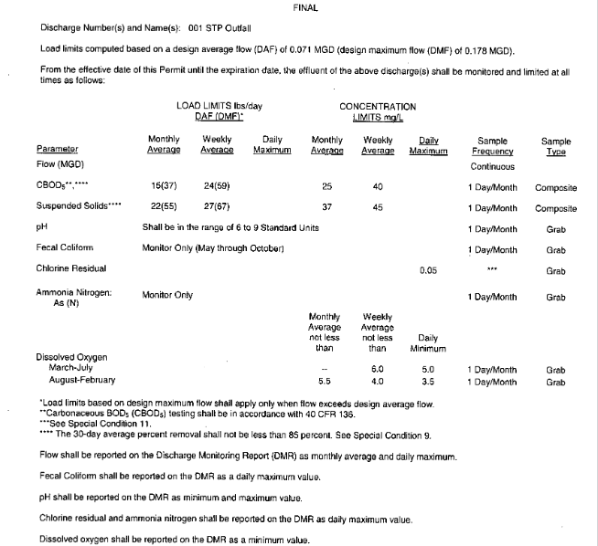
Effluent limits

Slide 39
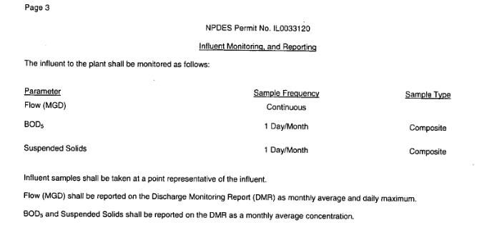
Influent limits

Slide 40
Special conditions

Slide 41
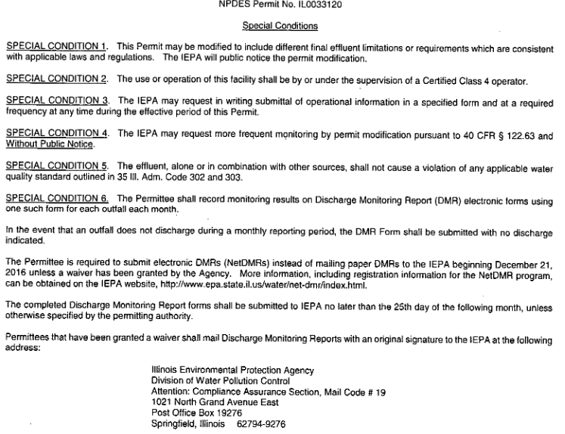

Slide 42
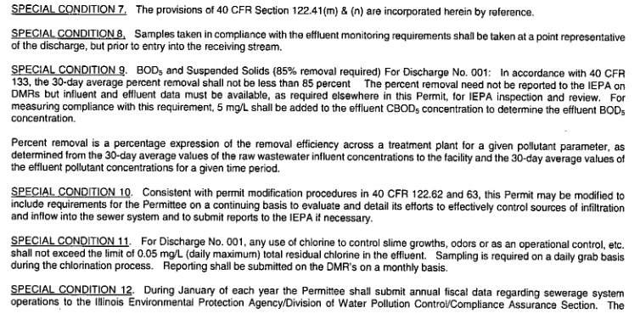

Slide 43
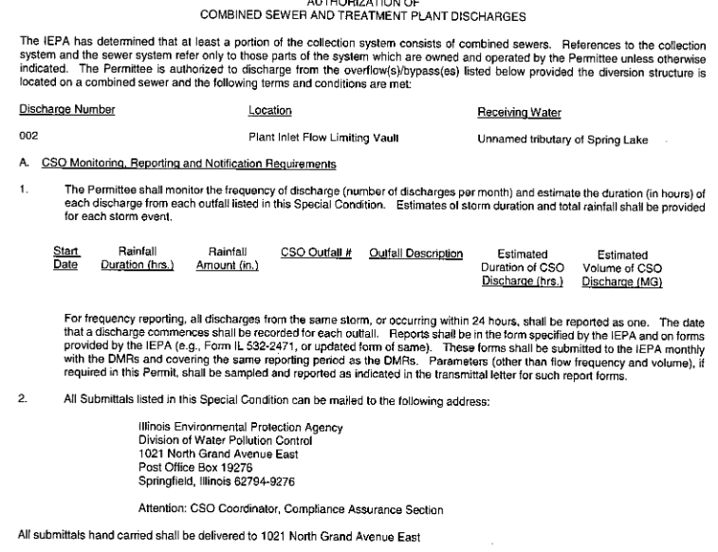

Slide 44
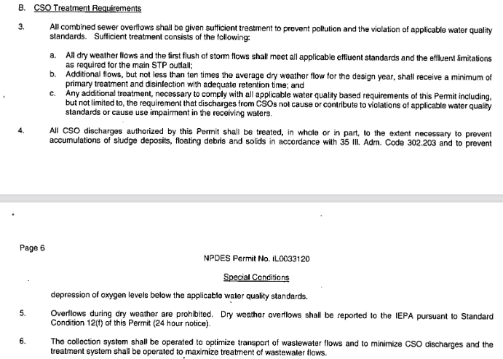

Slide 45
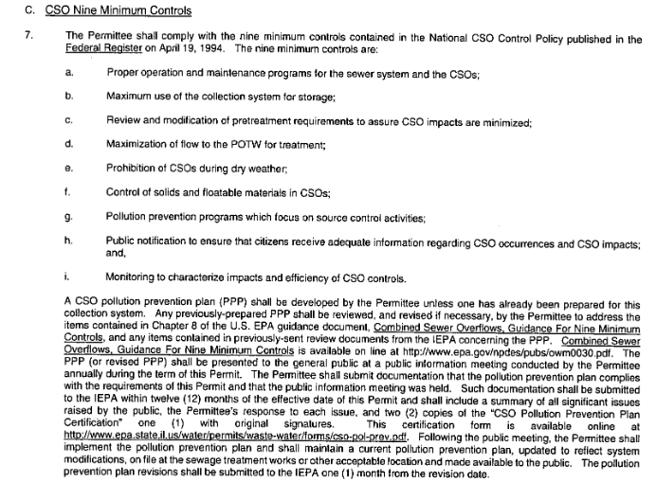

Slide 46
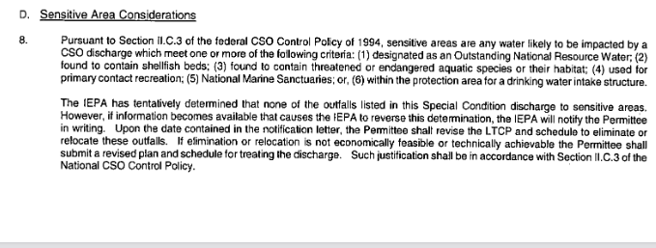

Slide 47
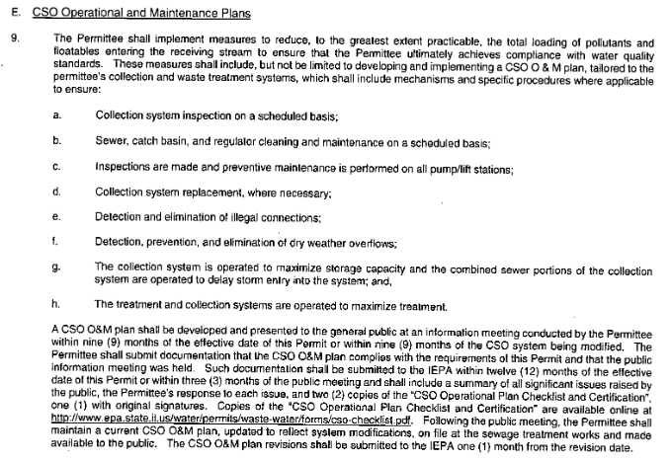

Slide 48
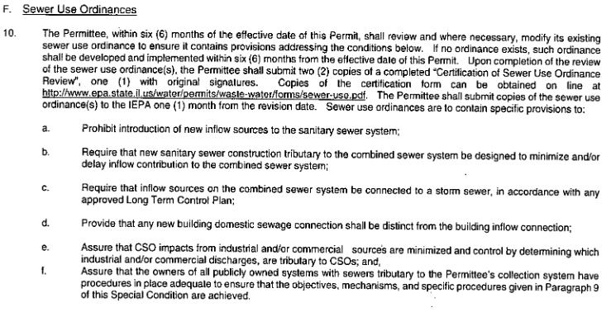

Slide 49
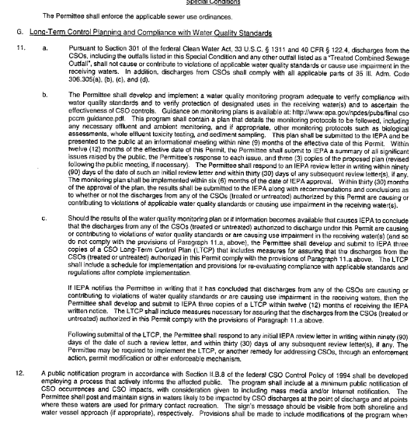

Slide 50
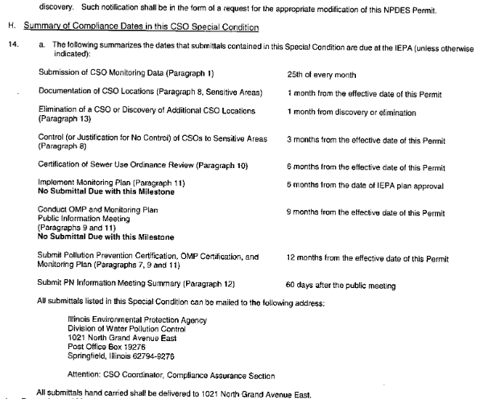

Slide 51
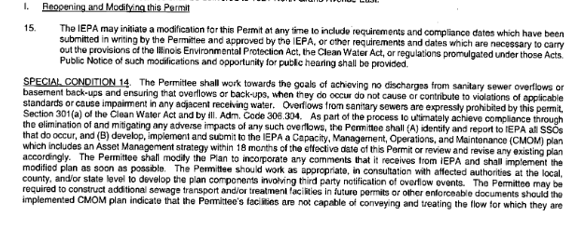

Slide 52
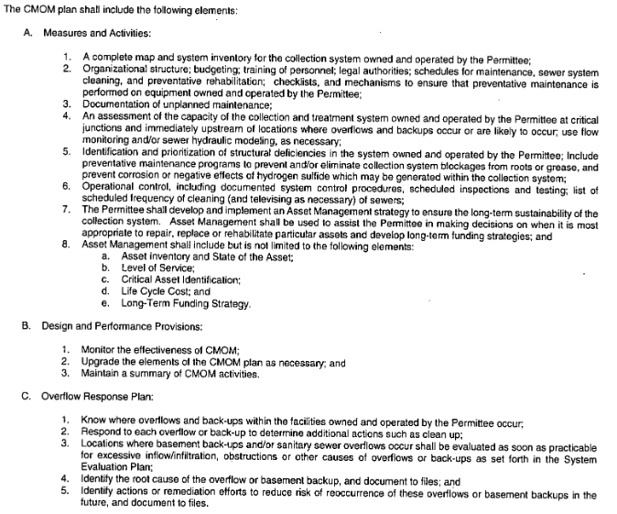

Slide 53
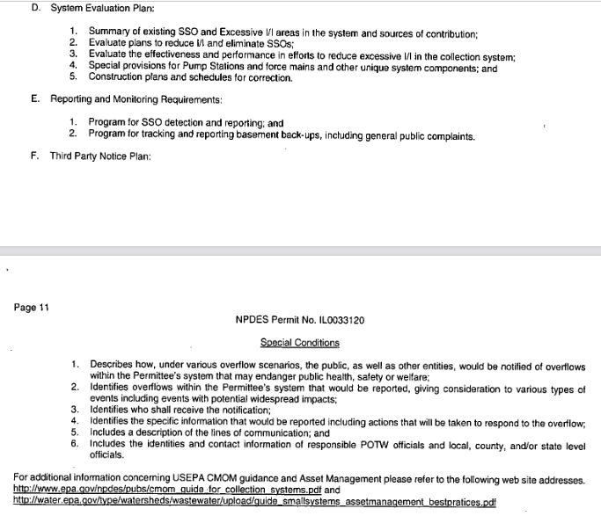

Slide 54
Standard conditions

Slide 55


Slide 56


Slide 57
Drinking water Plant Npdes

Slide 58

Water Supply Industry

Slide 59

2019 Tons of pollutants Reported From
Drinking Water treatment systems

Slide 60

Pollution from drinking water treatment

Slide 61

Pollutants from drinking water treatment based on # of exceedances

Slide 62


Slide 63

Clean water act discharge prohibition

Slide 64

National recommended criteria for aquatic life

Slide 65
What can I do to reduce discharge pollutants?

Slide 66

Source controls

Slide 67

Treatment systems

Slide 68


Slide 69

dechlorination

Slide 70
Add treatment
Sand Filters
Lagoons
Clarifiers
Thickeners
Filter Press

Slide 71

Other options

Slide 72
nutrients
NPDES Regulations

Slide 73
Nutrient Standards
The USEPA approach is to establish a WQS and then regulate all facilities with a Water Quality Based Effluent Limit
However, because Illinois has been unable to develop a numeric water quality standard for P in streams, USEPA has taken the approach that IEPA must regulate using the narrative WQS that prohibits excess algae growth
Segments listed as algae or plant impaired = violation of narrative standard
  Impairment is based on a visual observation of excess algae or plants + poor aquatic life
DO impairment that is indicative of excess algae

Slide 74
Nutrient Standards (cont.)
USEPA has written IEPA letters insisting that we regulate
P immediately where violations of the existing narrative standard exist
As a result of this push from USEPA, and existing effluent standards for P, 60% of major municipal treatment plants have, or will have, a 1 mg/L P limit. This represents 80% of the design average flow
IEPA now has a two-pronged obligation:
  Regulate P now where downstream algae/plants are a problem
  Formulate regulations for the future

Slide 75


Slide 77
Who gets Nutrient Limits? (Current)
Major municipal facilities (1.0 MGD) and those with a phosphorus effluent load of 25 lbs/day who are expanding
  Phosphorus Limit of 1.0 mg/L
  Nitrogen removal, unless it is not affordable. They will then have a goal of total nitrogen
Minor facilities who are expanding
  Phosphorus and nitrogen removal, unless it is not affordable based on the “Interim Economic Guidance for Water Quality Standards” (EPA-823-B-95-002)
Discharge to or upstream of algae impaired waters and possibly D.O. impaired waters
When watershed has had a TMDL completed and the NPDES permit is being renewed

Slide 78

Questions?
This Photo by Unknown Author is licensed under CC BY-NC-ND

